Slide 1

# Revolutionizing Weather Prediction with IBM SPSS Modeler
This presentation outlines a project leveraging IBM SPSS Modeler for enhanced weather forecasting. We'll explore data integration, advanced modeling, and impactful applications. The project showcases the power of predictive analytics in meteorology. Weather prediction is crucial for public safety, economic stability, and environmental management. This project aims to improve accuracy and reliability, leading to better preparedness and decision-making.

Slide 2

Project Overview
Presented by : Ayush Raj Sinha.
Rashi Gupta
COURSE: B.Tech CS -DS+AI, 43 & 44.
Data Aggregation
Modeling
Collect weather data from various global sources.
Use modeling technquie for weather predictions.

Slide 3
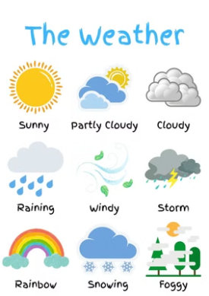
# Project Overview
The project aggregates global weather data from diverse sources . Our goal is to build aaccurate and reliable weather prediction model using IBM SPSS Modeler. This will enable better forecasting of weather patterns, supporting informed decision-making in agriculture, disaster management, and resource allocation.

Slide 4

The project aggregates global weather data from diverse sources.
Multiple data streams are integrated .
Data cleaning removes errors and inconsistencies.
Missing values are handled using appropriate techniques.

Slide 5
# Data Audit Node and Dataset Import
After importing the data set, connect it to the Data Audit Node. The Data Audit node is used to gain insights.
It provides summary statistics and visualizations.
It identifies issues, such as missing values and outliers.
These insights inform data cleaning and preprocessing.

Slide 6

Modeling involves choosing the best algorithm for the dataset. CHAID (Chi-squared Automatic Interaction Detection) is a decision tree technique.
CHAID identifies statistically significant relationships.
It simplifies complex data interactions.
CHAID modelling helps predict weather conditions based on various factors.

Slide 7
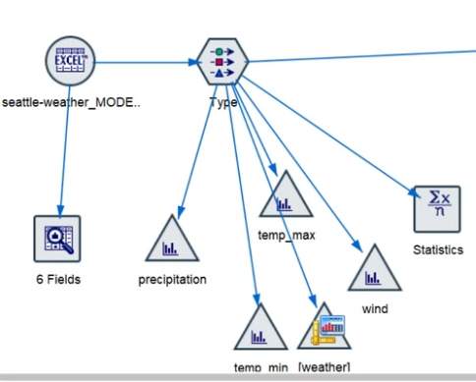
# Data Visualization for Insights
Data visualization is crucial for understanding weather patterns. Using tools like histograms, scatter plots, within the weather data. These visualizations enable informed decision-making and effective communication of findings.

Slide 8
# Model Deployment and Nugget Connection
The model is deployed to predict real-time weather.
Connect deployed model to a Nugget node.
The Select node filters for specific weather conditions.
These could include drizzle, fog, sun, or rain.

Slide 9
# Potential Applications
Optimized Agricultural Planning: Enhance crop yields through precise weather forecasting.
Resilient Urban Infrastructure: Improve climate resilience by predicting and mitigating weather-related risks.
Efficient Renewable Energy: Optimize resource allocation with accurate weather data for renewable energy production.
Enhanced Global Climate Research: Foster better understanding and prediction of global climate patterns.

Slide 10
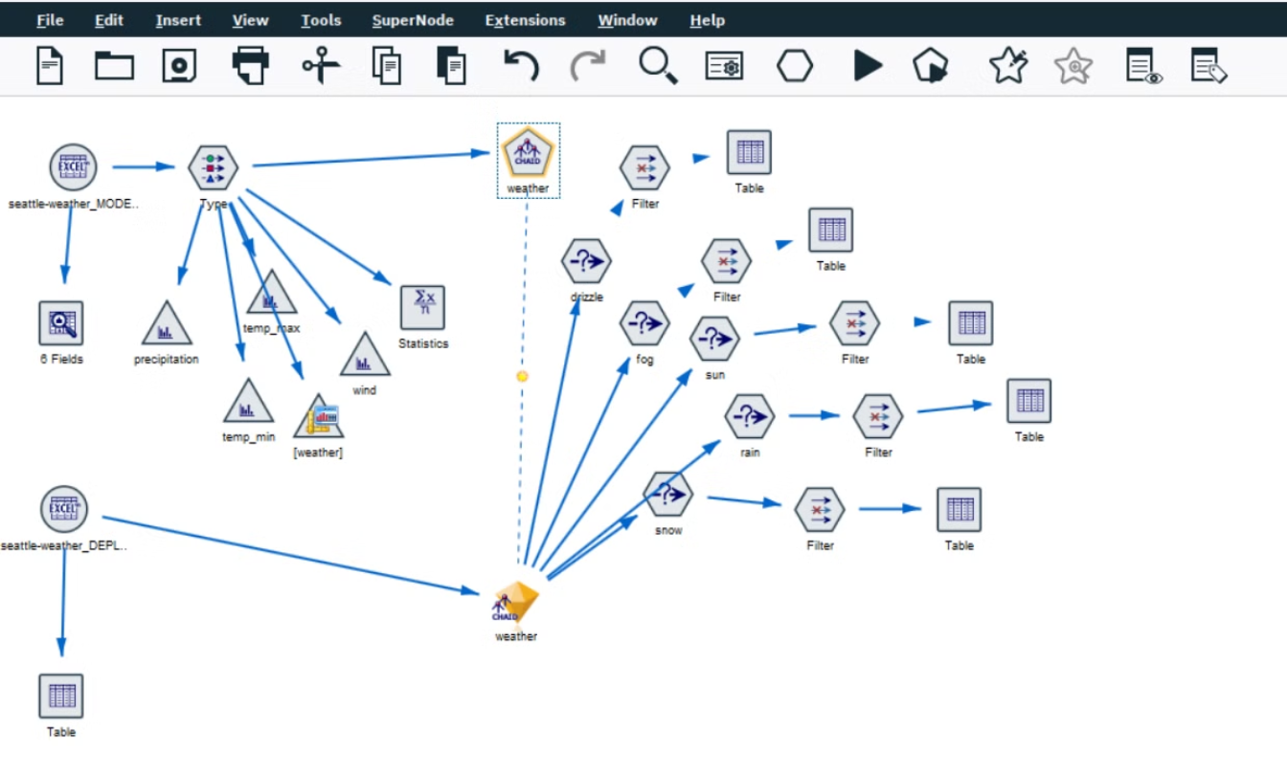

Slide 11




Key Nodes Explained
CHAID Modeling Node
Analyzes data, creating predictive models.
Nugget Node
Represents the deployed model for use.
Select Node
Filters data to show weather conditions.
Final Output
Presents weather forecast predictions.

Slide 12

Thank You
Thank you for your time and attention today. We appreciate the opportunity to present our work on weather prediction with IBM SPSS Modeler.

